Slide 1


Day 6
Math24 (Differential Equations)
Ch 2.2 Separable Equations (Page 42-51)
Elementary Differential Equations and Boundary Value Problems, 10th edition, by William E. Boyce and Richard C. DiPrima, ©2013 by John Wiley & Sons, Inc.

Slide 2
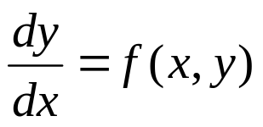
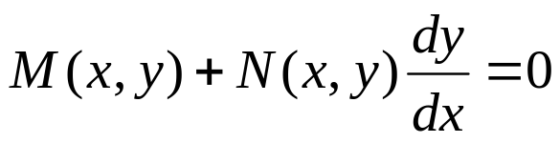


In this section we examine a subclass of linear and nonlinear first order equations. Consider the first order equation
We can rewrite this in the form
For example, let M(x,y) = - f (x,y) and N (x,y) = 1. There may be other ways as well. In differential form,
If M is a function of x only and N is a function of y only, then
In this case, the equation is called separable.

Slide 3
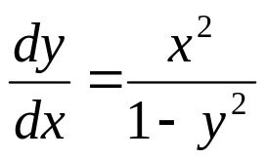
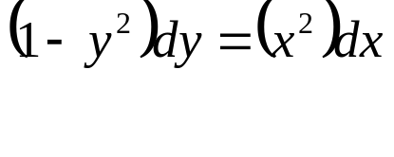
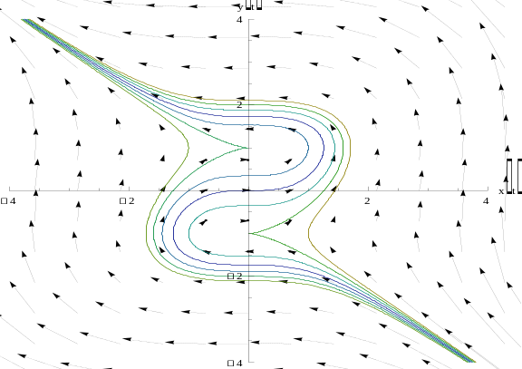
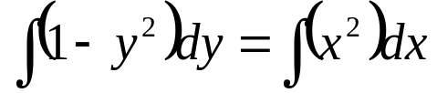
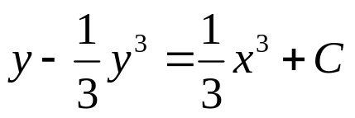

Example 1: Solving a Separable Equation
Solve the following first order nonlinear equation:
Separating variables, and using calculus, we obtain
The equation above defines the solution y implicitly. A graph showing the direction field and implicit plots of several solution curves for the differential equation is given above.

Slide 4
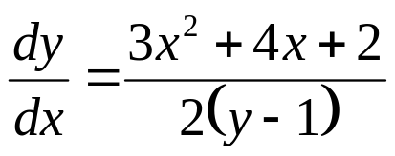

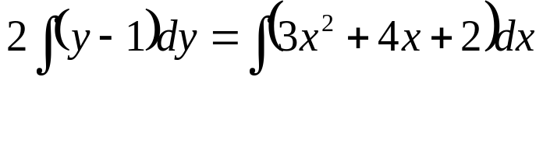

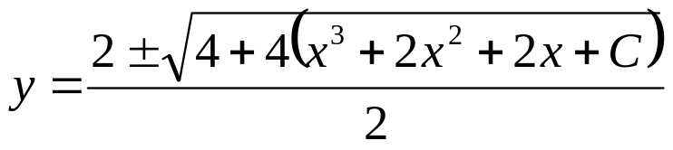
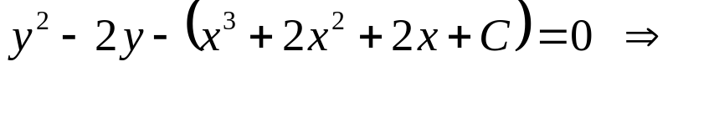

Example 2:
Implicit and Explicit Solutions (1 of 4)
Solve the following first order nonlinear equation:
Separating variables and using calculus, we obtain
The equation above defines the solution y implicitly. An explicit expression for the solution can be found in this case:

Slide 5
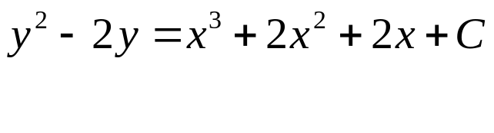


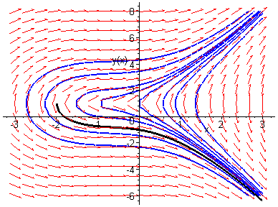
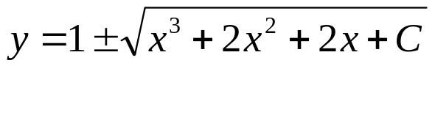


Example 2: Initial Value Problem (2 of 4)
Suppose we seek a solution satisfying y(0) = -1. Using the implicit expression of y, we obtain
Thus the implicit equation defining y is
Using an explicit expression of y,
It follows that

Slide 6
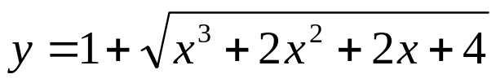
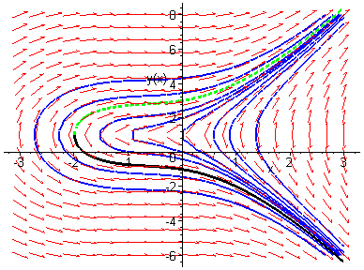
Example 2: Initial Condition y(0) = 3 (3 of 4)
Note that if initial condition is y(0) = 3, then we choose the positive sign, instead of negative sign, on the square root term:

Slide 7
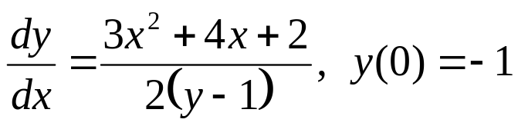

Example 2: Domain (4 of 4)
Thus the solutions to the initial value problem
are given by
From explicit representation of y, it follows that
and hence the domain of y is (-2, ∞). Note x = -2 yields y = 1, which makes the denominator of dy/dx zero (vertical tangent).
Conversely, the domain of y can be estimated by locating vertical tangents on the graph (useful for implicitly defined solutions).

Slide 8
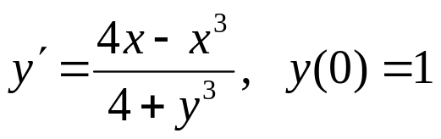

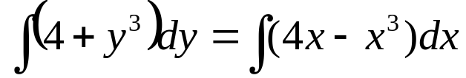
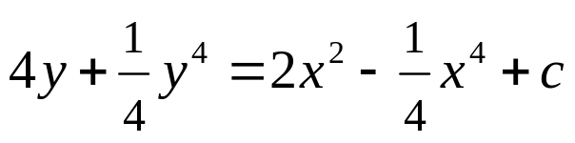

Example 3: Implicit Solution of an Initial Value Problem (1 of 2)
Consider the following initial value problem:
Separating variables and using calculus, we obtain
Using the initial condition, y(0)=1, it follows that C = 17.

Slide 9
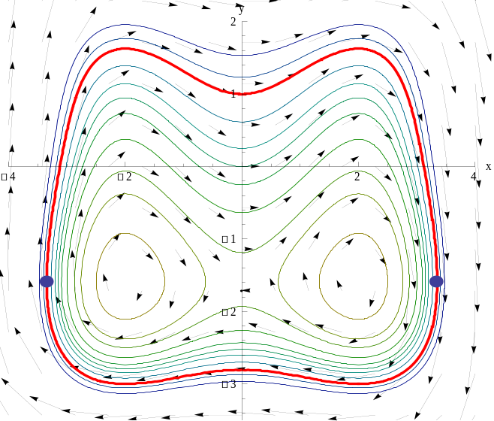


Example 3: Graph of Solutions (2 of 2)
The graph of this particular solution through (0, 2) is shown in red along with the graphs of the direction field and several other solution curves for this differential equation, are shown:
The points identified with blue
dots correspond to the points on
the red curve where the tangent
line is vertical:
but at all
points where the line connecting the
blue points intersects solution curves
the tangent line is vertical.

Slide 10
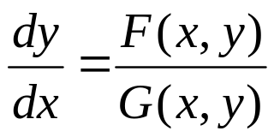
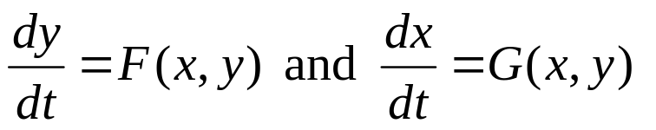
Parametric Equations
The differential equation:
is sometimes easier to solve if x and y are thought of as dependent variables of the independent variable t and rewriting the single differential equation as the system of differential equations:
Chapter 9 is devoted to the solution of systems such as these.

